Slide 1
Learning Objective
I will be able to determine the gradient of the tangent line using derivative
Success Criteria
At the end of the lesson, I will be able to:
Determine the gradient of the tangent line using derivative

Slide 2
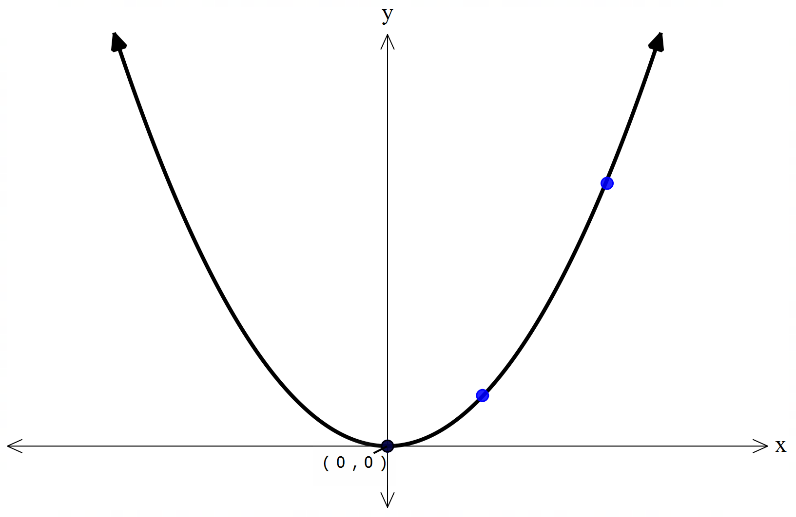
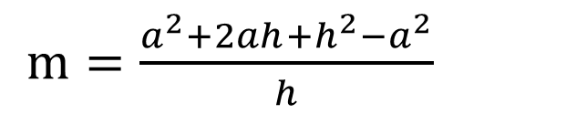

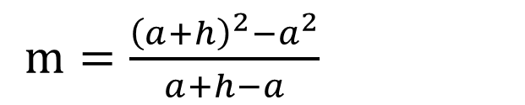
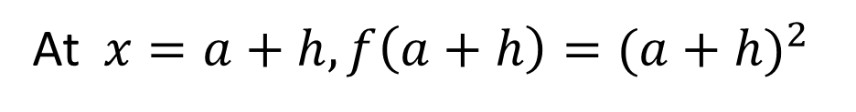


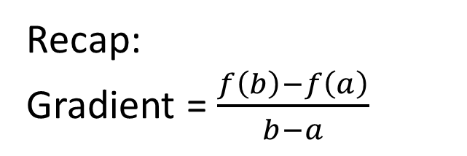
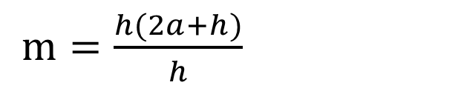
Instantaneous rate of change
Activating Prior Knowledge
Consider the function $f\left(x\right)=x^{2}$
At$x=a, f\left(a\right)=a^{2}$
At$x=a+h, f\left(a+h\right)={(a+h)}^{2}$
Q
Recap:
Gradient = $\frac{f\left(b\right)−f\left(a\right)}{b−a}$
P
$m=\frac{{{\left(a+h\right)}^{2}−a}^{2}}{a+h−a}$
$m=\frac{{a^{2}+2ah+h^{2}−a}^{2}}{h}$
$m=\frac{h(2a+h)}{h}$
$m=2a+h$

Slide 3



Instantaneous rate of change
Concept Development
Consider the function $f\left(x\right)=x^{2}$
At$x=a, f\left(a\right)=a^{2}$
At$x=a+h, f\left(a+h\right)={(a+h)}^{2}$
Q
Recap:
Gradient = $\frac{f\left(b\right)−f\left(a\right)}{b−a}$
P
$m=2a+h$
Consider as $h→0,$ what happens to $m?$
$$m=\lim_{h→0}{2a+h}$$
$m=2a$

Slide 4
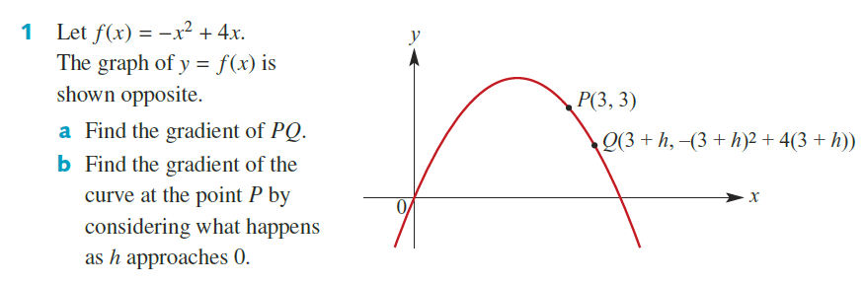


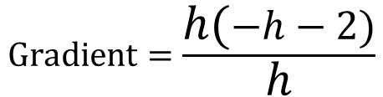
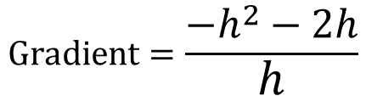

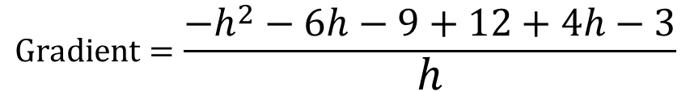

Guided Practice
G$radient of PQ=\frac{−{\left(3+h\right)}^{2}+4\left(3+h\right)−3}{3+h−3}$
$$Gradient=\lim_{h→0}{−h−2}$$
$$Gradient=\frac{−h^{2}−6h−9+12+4h−3}{h}$$
$$Gradient=−2$$
$$Gradient=\frac{−h^{2}−2h}{h}$$
$$Gradient=\frac{h(−h−2)}{h}$$
$$Gradient=−h−2$$

Slide 5

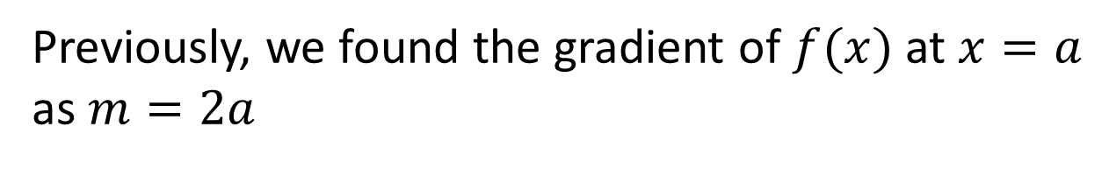
Derivative
Concept Development
Consider the function $f\left(x\right)=x^{2}$
Q
Find the derivative of $f(x)$
Previously, we found the gradient of $f(x)$ at $x=a$ as $m=2a$
P
$$∴we can say the derivative of f\left(x\right) is 2x$$

Slide 6
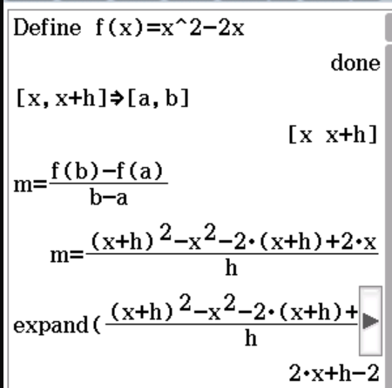





Guided Practice
G$radient of PQ=\frac{{\left(x+h\right)}^{2}−2\left(x+h\right)−(x^{2}−2x)}{x+h−x}$
$$Gradient=2x+h−2$$
$$Gradient=\lim_{h→0}{2x+h−2}$$
$$Gradient=2x−2$$
$$Derivative=2x−2$$

Slide 7
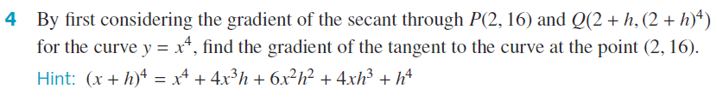
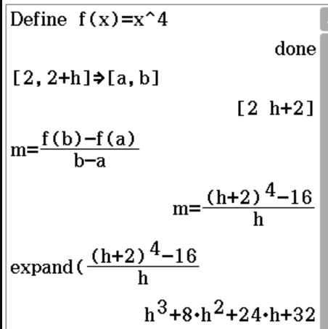



Guided Practice
G$radient of PQ=\frac{{\left(2+h\right)}^{4}−16}{2+h−2}$
$$Gradient=h^{3}+8h^{2}+24h+32$$
$$Gradient=\lim_{h→0}{h^{3}+8h^{2}+24h+32}$$
$$Gradient=32$$

Slide 8
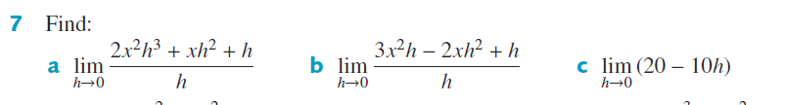
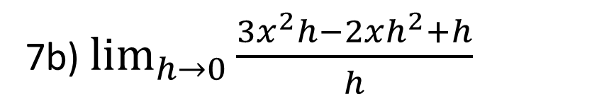

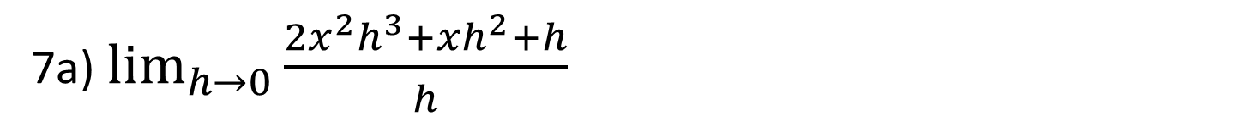

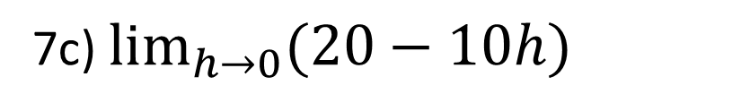



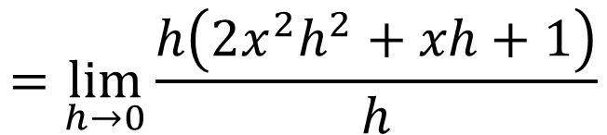
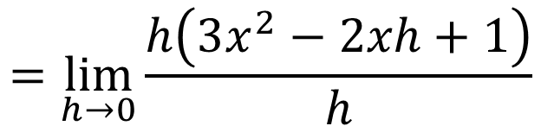
Guided Practice
7b) $\lim_{h→0}{\frac{3x^{2}h−2xh^{2}+h}{h}}$
7a) $\lim_{h→0}{\frac{2x^{2}h^{3}+xh^{2}+h}{h}}$
$$=\lim_{h→0}{\frac{h\left(2x^{2}h^{2}+xh+1\right)}{h}}$$
$$=\lim_{h→0}{\frac{h\left(3x^{2}−2xh+1\right)}{h}}$$
$$=\lim_{h→0}{2x^{2}h^{2}+xh+1}$$
$$=\lim_{h→0}{2\left(3x^{2}−2xh+1\right)}$$
$$=3x^{2}+1$$
$$=1$$
7c) $\lim_{h→0}{(20−10h)}$
$$=20$$

Slide 9





Derivative by First Principles
Concept Development
Consider the function $f\left(x\right)=x^{2}$
Q
We can determine the derivative of function by evaluating the limit ($eg.as h→0)$.
$$This is called the differentiation by first principles$$
P
Differentiation by first principle is denoted by$f′(x)$
$$f^{′}\left(x\right)=\lim_{h→0}\frac{f\left(x+h\right)−f(x)}{x+h−x}$$
$$=\lim_{h→0}\frac{f\left(x+h\right)−f(x)}{h}$$

Slide 10

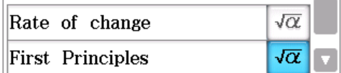
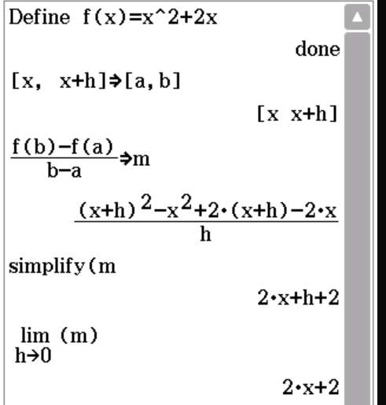

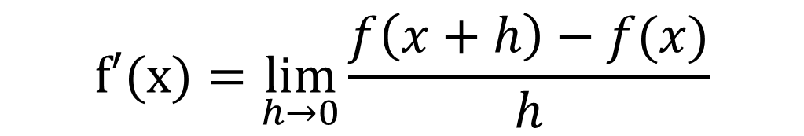
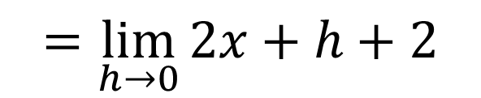
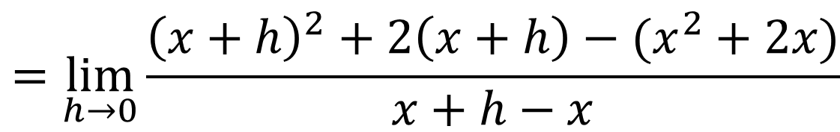
Guided Practice
$$f′(x)=\lim_{h→0}{\frac{f\left(x+h\right)−f(x)}{h}}$$
$$=\lim_{h→0}{\frac{{\left(x+h\right)}^{2}+2\left(x+h\right)−(x^{2}+2x)}{x+h−x}}$$
$$=\lim_{h→0}{2x+h+2}$$
$$f′(x)=2x+2$$

Slide 11



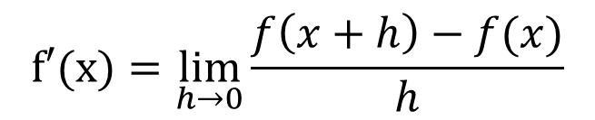


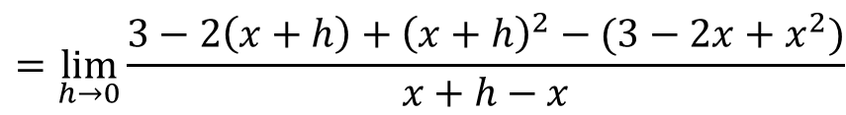

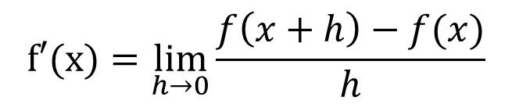
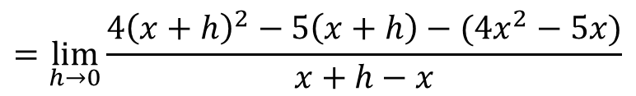
Guided Practice
$$f′(x)=\lim_{h→0}{\frac{f\left(x+h\right)−f(x)}{h}}$$
$$f′(x)=\lim_{h→0}{\frac{f\left(x+h\right)−f(x)}{h}}$$
$$=\lim_{h→0}{\frac{4{\left(x+h\right)}^{2}−5\left(x+h\right)−(4x^{2}−5x)}{x+h−x}}$$
$$=\lim_{h→0}{\frac{3−2\left(x+h\right)+{\left(x+h\right)}^{2}−(3−2x+x^{2})}{x+h−x}}$$
$$=\lim_{h→0}{8x+4h−5}$$
$$=\lim_{h→0}{h−2+2x}$$
$$f^{′}\left(x\right)=8x−5$$
$$f^{′}\left(x\right)=2x−2$$

Slide 12
Independent Practice
Complete Cambridge Ex 17C

